Slide 1
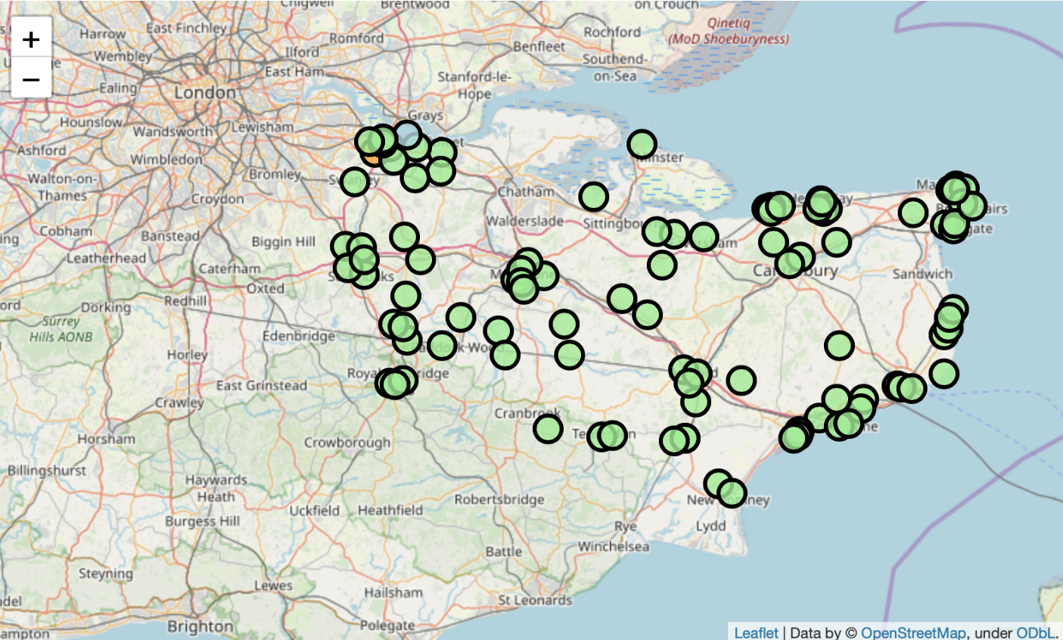
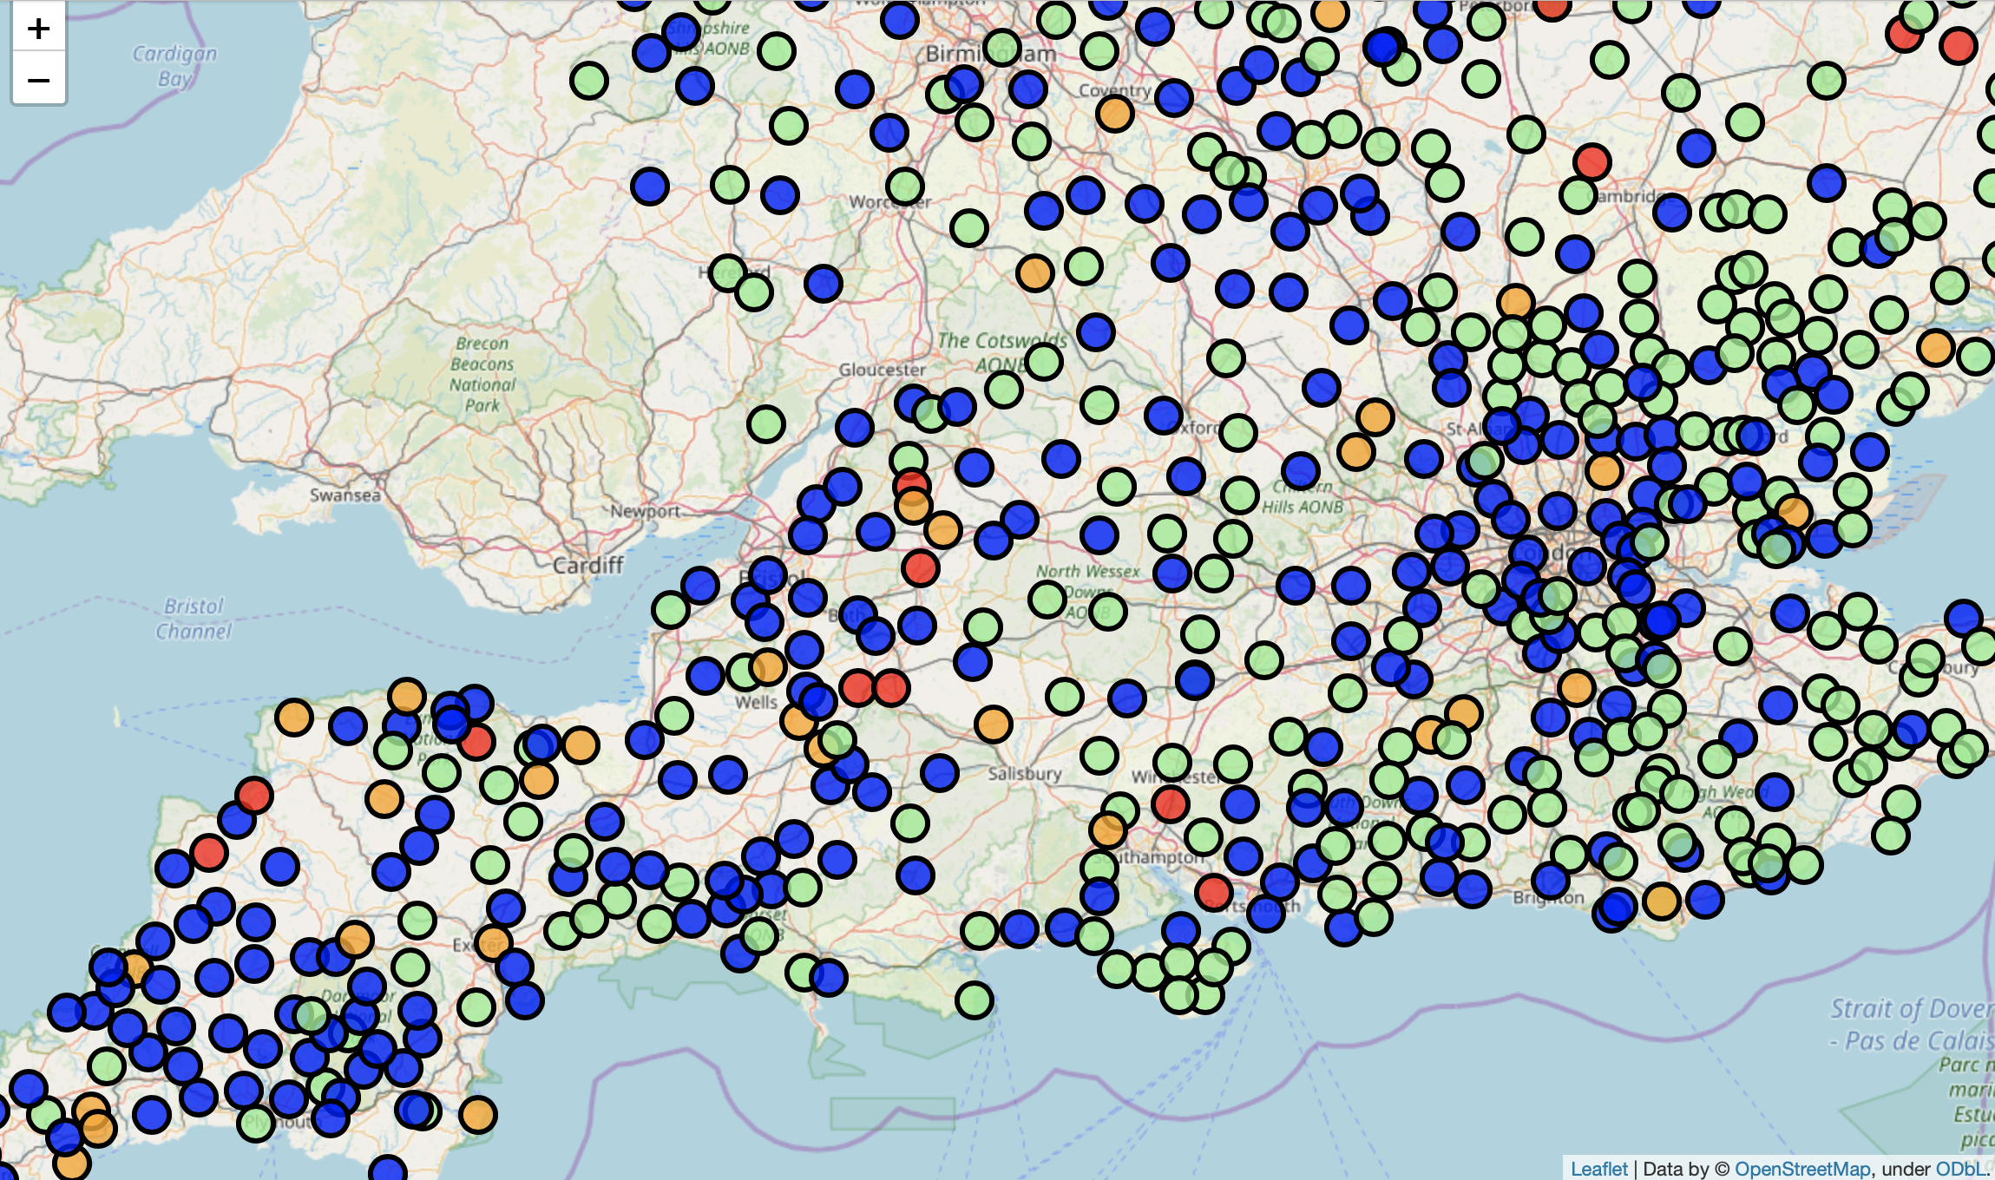
Extension 1
Extension 2
Red: > 99th percentile (13.9mm)
Orange: > 95th percentile (9.4mm)
Blue: > Average (2.34mm)
Light Green: < Average
Light green indicates no flood warning around the Canterbury area
Maps created through Folium

